Slide 1
Model Selection for Pion Photoproduction
J. Landay, M. Döring, C. Fernández Ramírez, B. Hu, and R. Molina

Slide 2
Problem: How to fit all of the data?
Source: S. Schumann et al. [A2 Collaboration], Phys. Lett. B 750, 252 (2015).

Slide 3
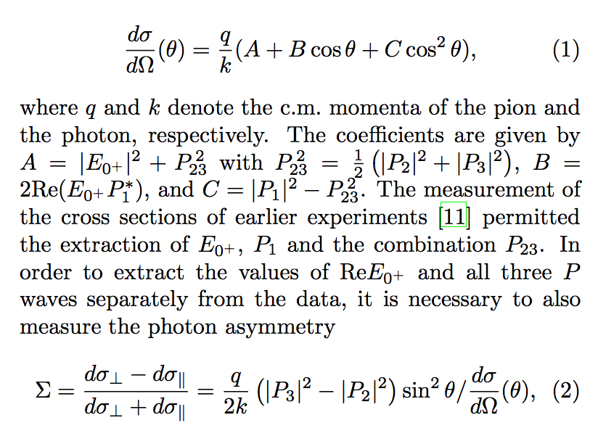
How we choose to parameterize…Multipoles!
Things to note
No angular dependence
Energy-dependent parameterization
All observables can be expressed as bilinear superposition of multipoles

Slide 4
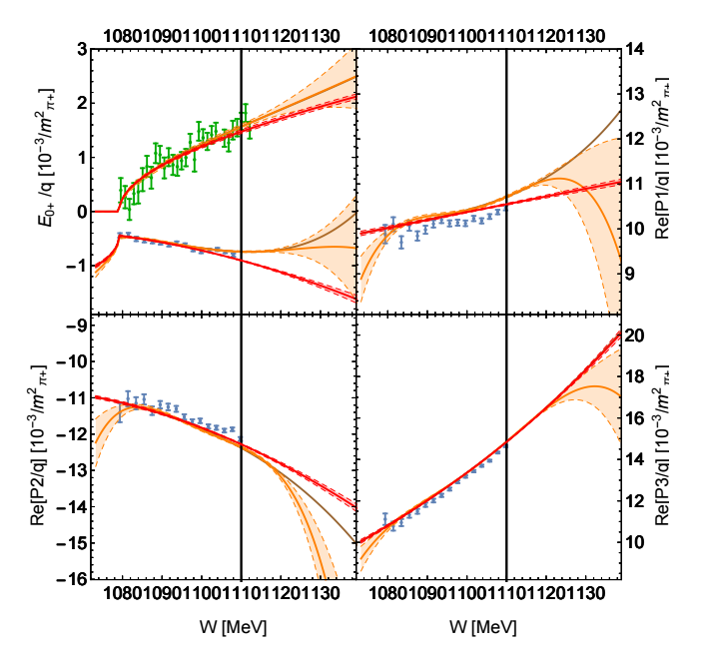
Different models can give satisfactory fits
All solutions pass Pearson’s Chi-Squared test.
Orange Solution- 23parameters
Red Solution – 13parameters

Slide 5
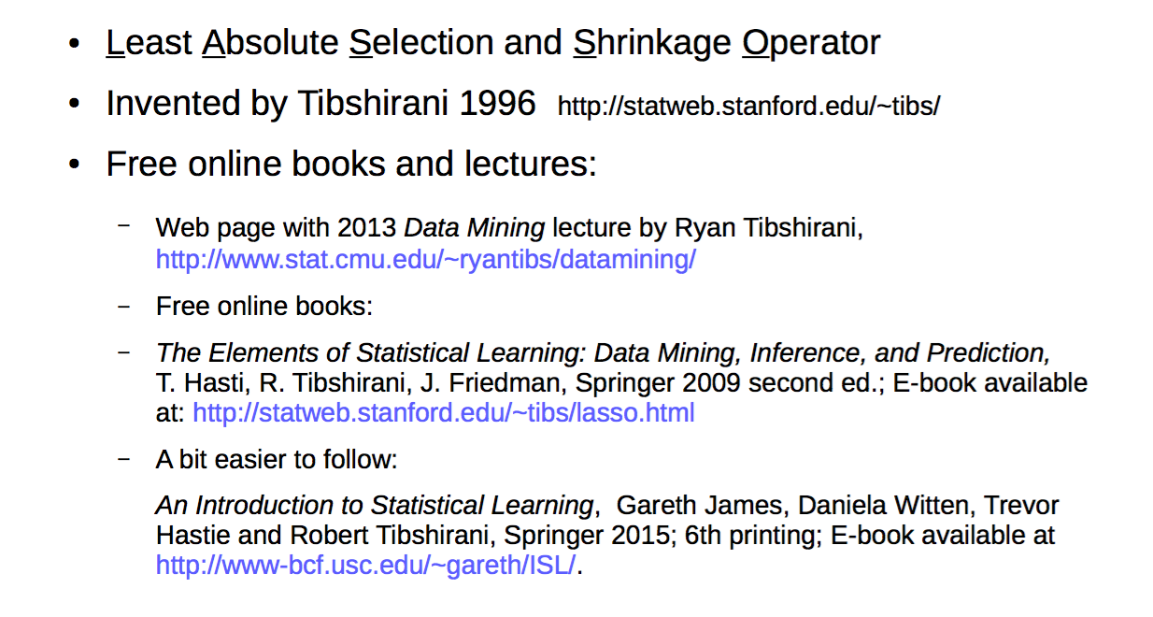
Solution— The LASSO

Slide 6
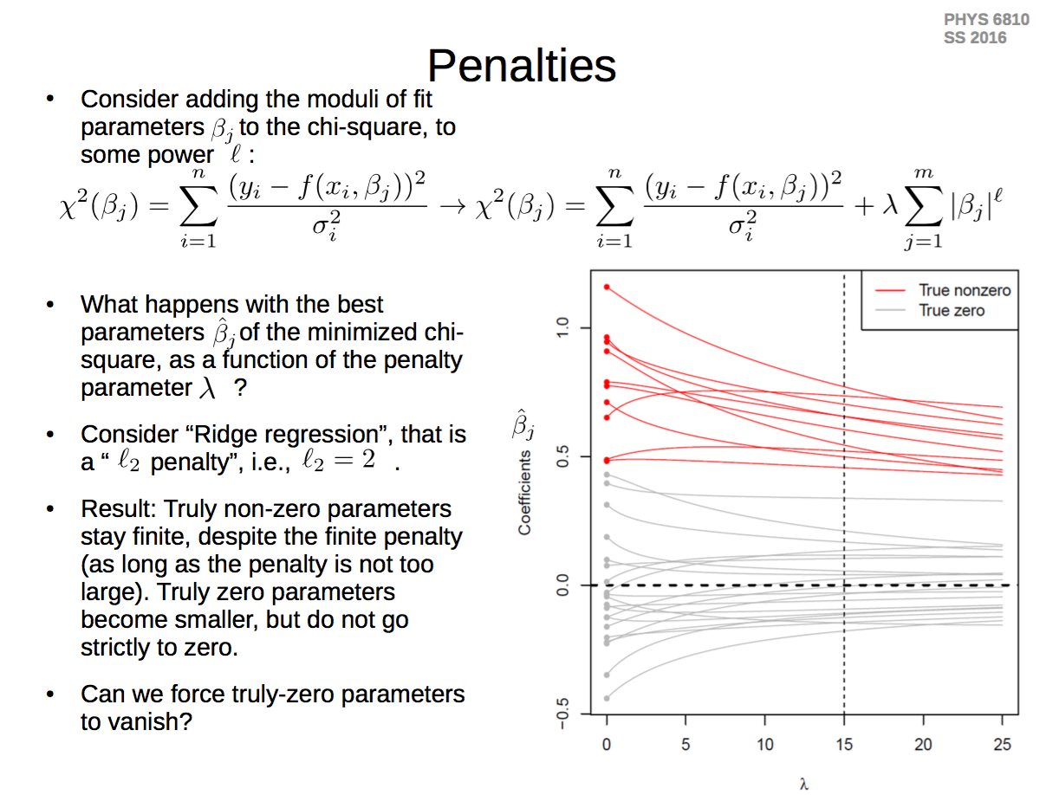
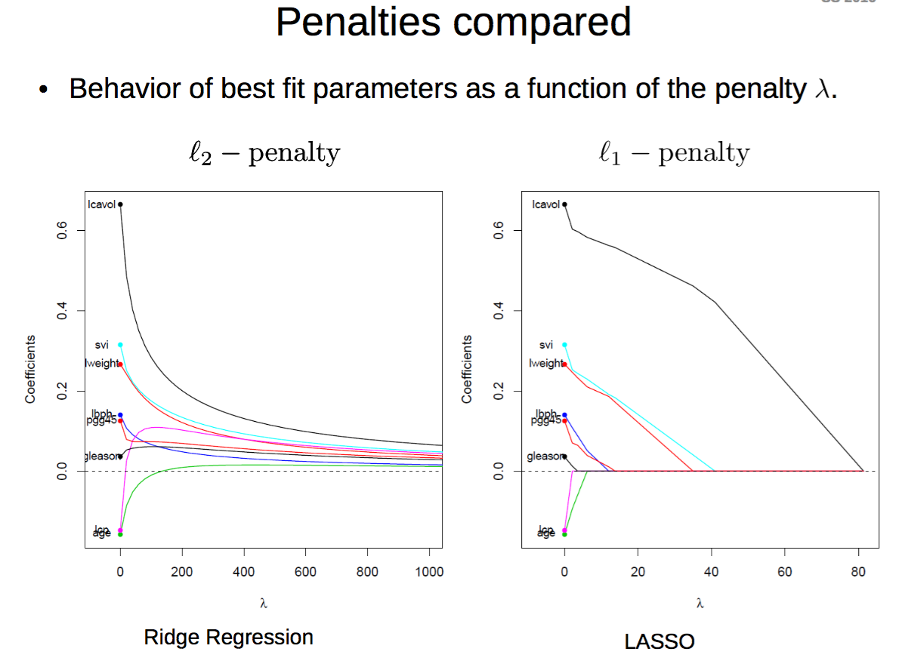
Lasso cont.

Slide 7
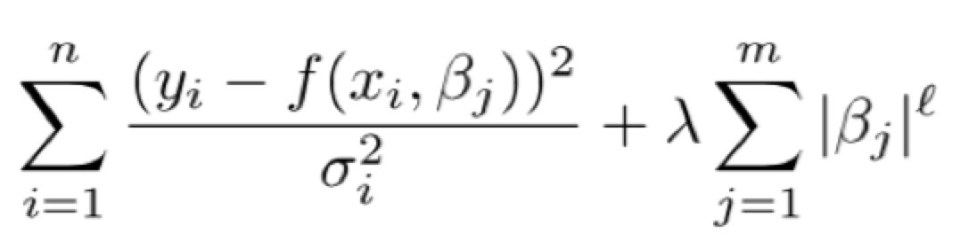
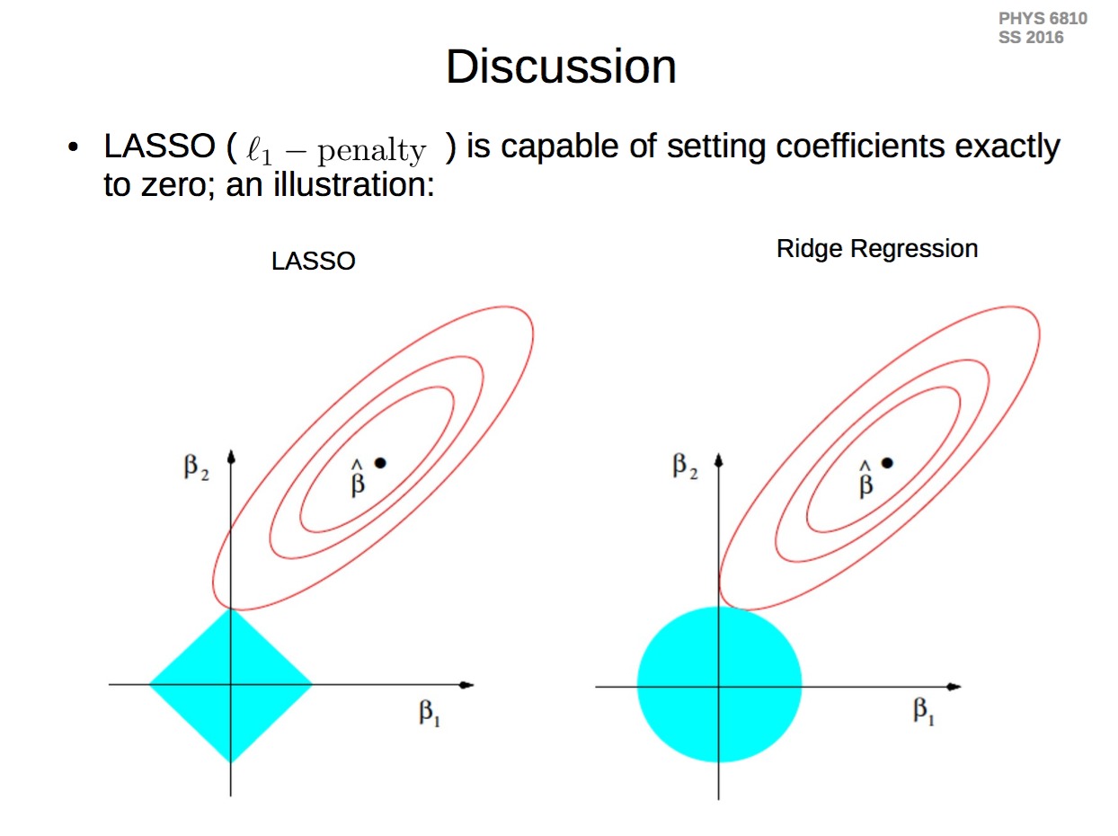
Parameters go to 0

Slide 8
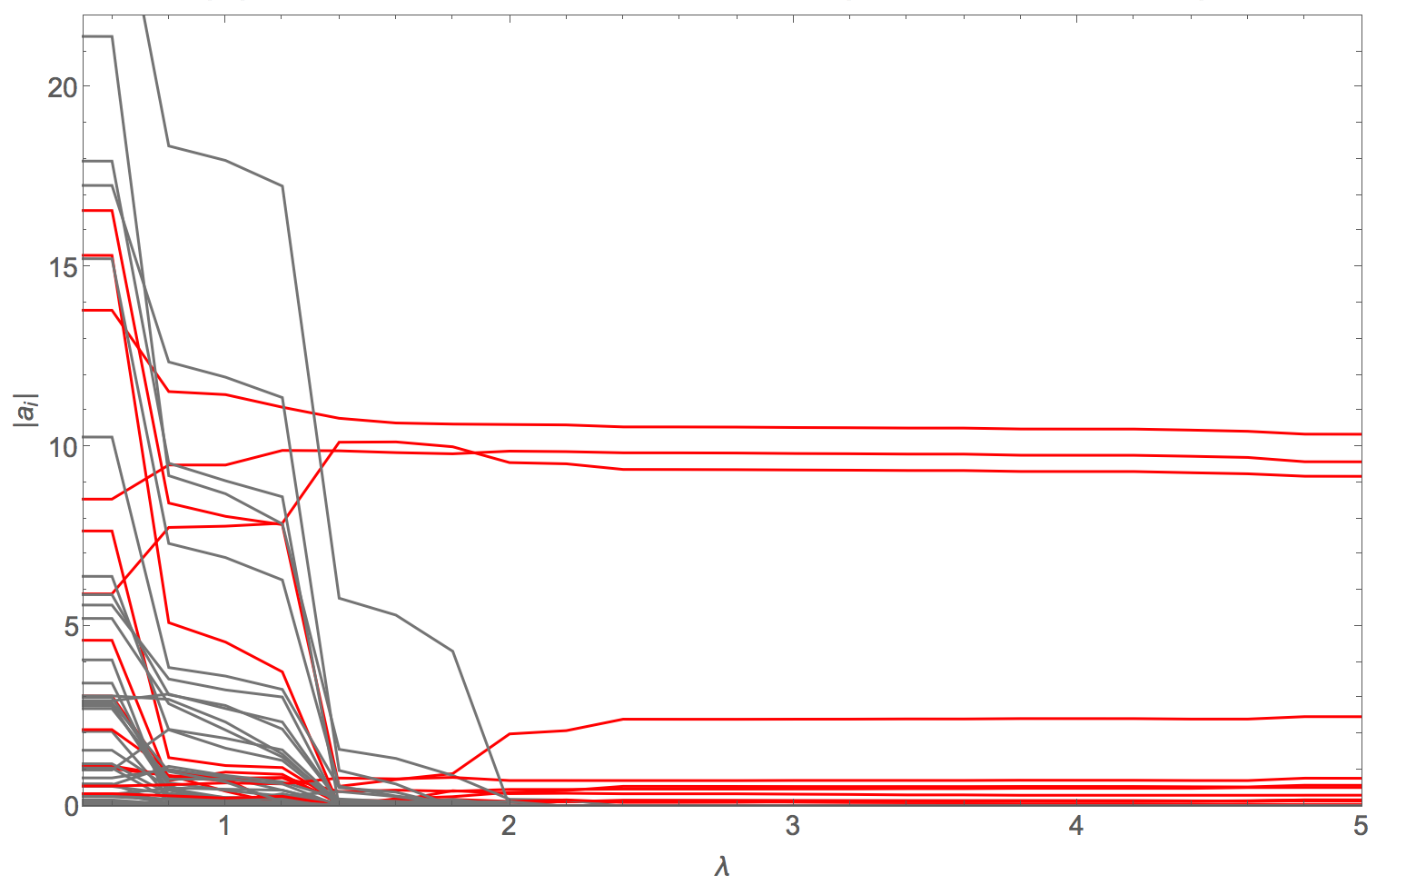
Lasso on Photoproduction data
Red- Non-Zero Parameters Gray- Zero-Parameters

Slide 9
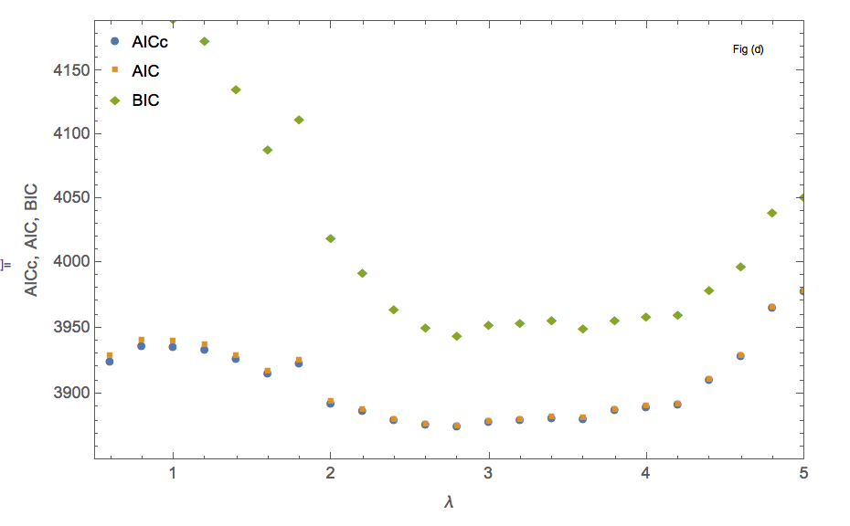
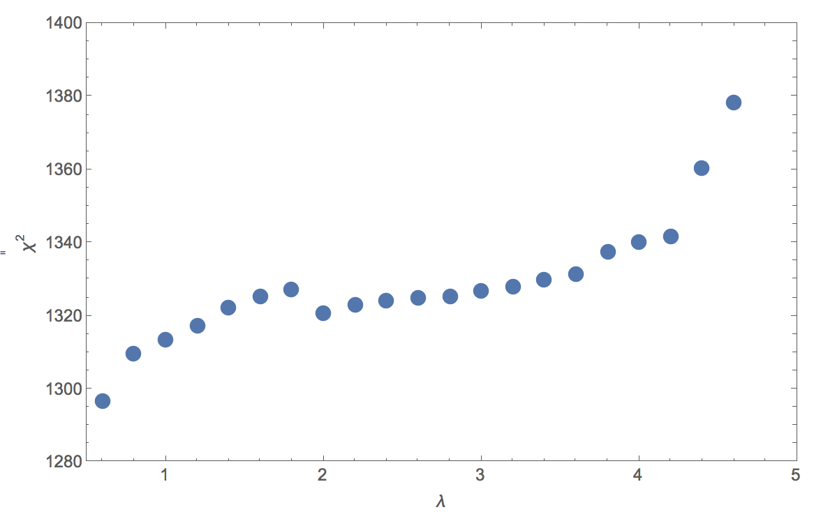
How to decide best value of λ?
AIC = 2k + χ² , k = number of parameters
AICc= AIC + 2k(k+1)/(n-k-1) , n= number of data points
BIC =k*ln(n) + χ²

Slide 10
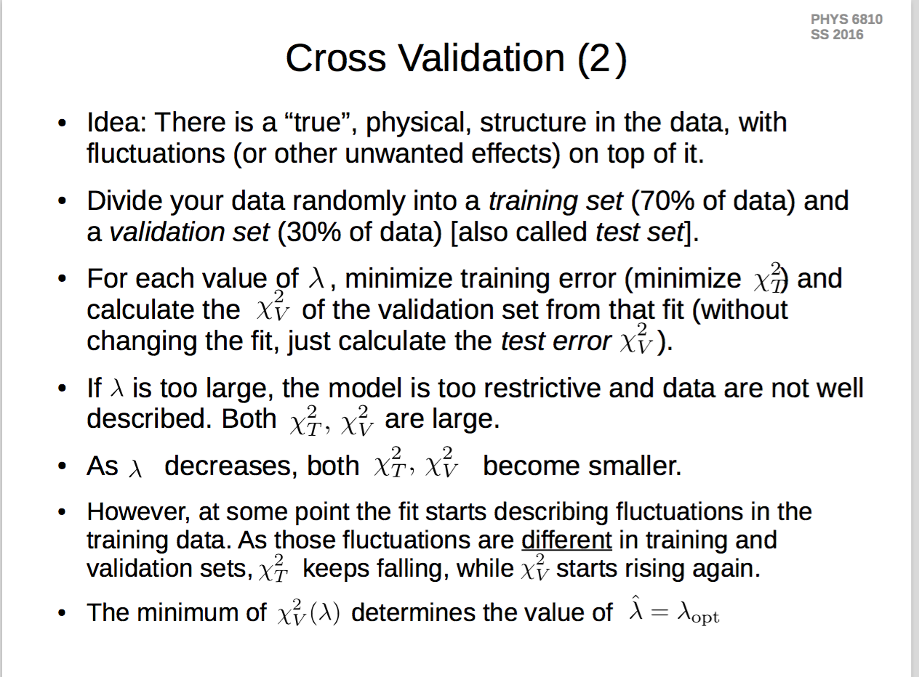
How to determine range of λ?

Slide 11
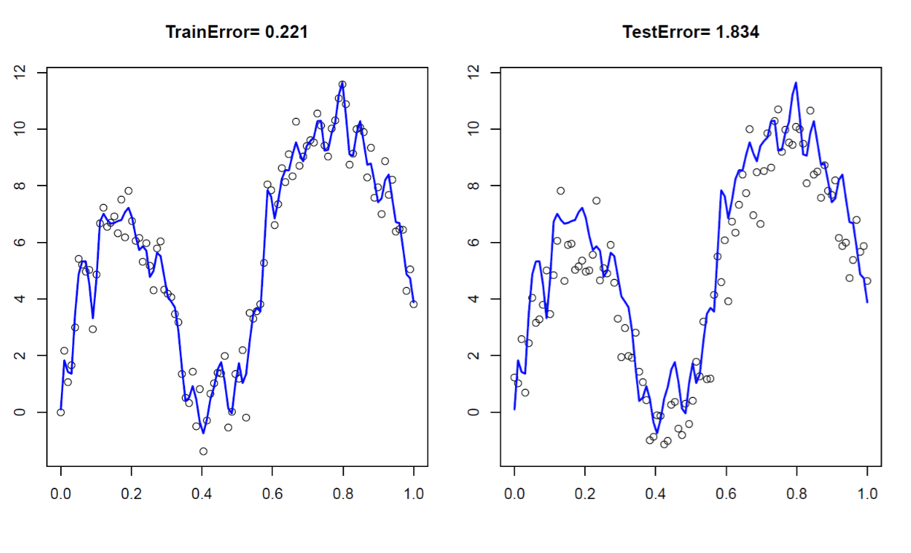
Why the test error rises again

Slide 12
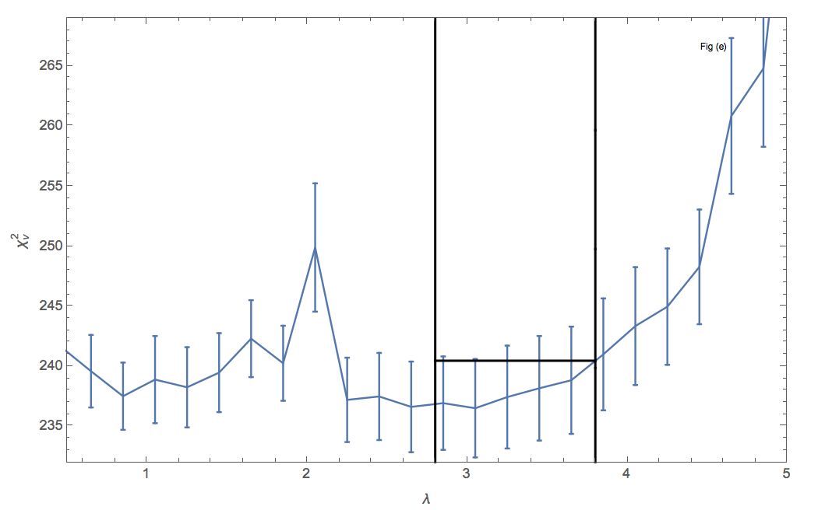
One Sigma Rule

Slide 13
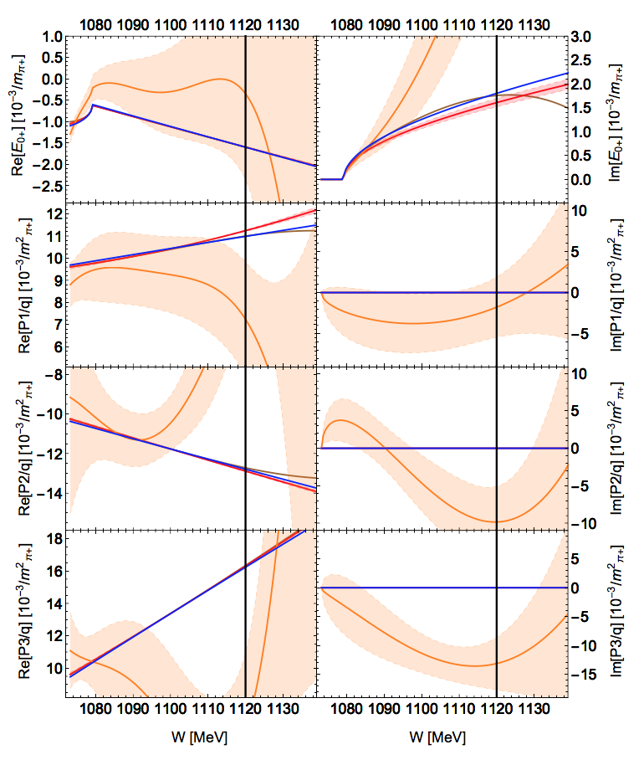
Toy Model Results
Blue: True Solution, 9 parameters
Purple: λ=0, 46 parameters
Red: λ=2.6, 10 parameters

Slide 14
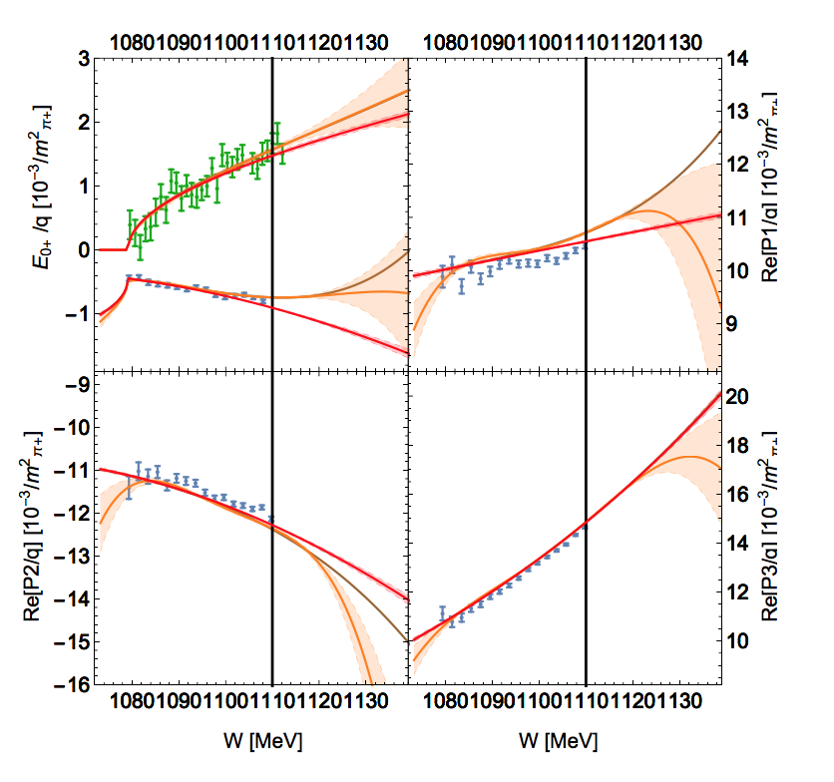
Real Data

Slide 15
Differential Cross Section

Slide 16
Target Polarization

Slide 17
Beam Asymmetry

Slide 18
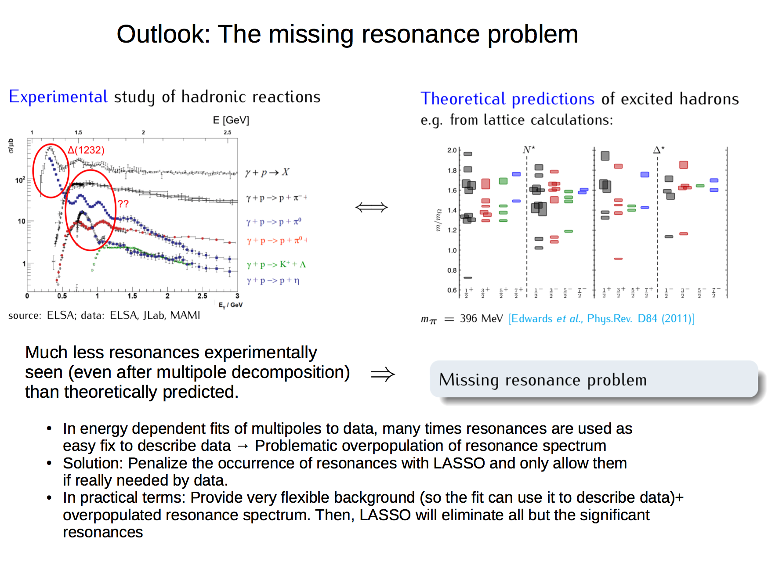

Slide 19
Conclusions
LASSO provides automatized method to scan larges classes of models and select the simplest one
In the case of pion photo-production LASSO fit results provide optimal accuracy and predictability.
LASSO has great potential to be used to look at resonance data and address missing resonance problem

